Slide 1
Exp 6 & 7
Multiplexer
Demultiplexer

Slide 2
Multiplexer
Multiplexer is a combinational circuit that has maximum of 2^{n} data inputs, ‘n’ selection lines and single output line.
One of these data inputs will be connected to the output based on the values of selection lines.
Since there are ‘n’ selection lines, there will be 2^{n} possible combinations of zeros and ones.
So, each combination will select only one data input.
Multiplexer is also called as Mux.

Slide 3
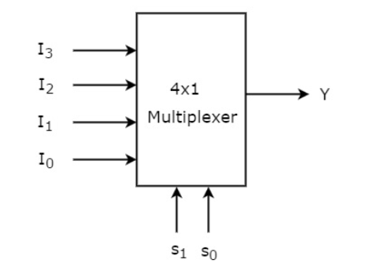
4x1 Multiplexer
4x1 Multiplexer has four data inputs I₃ , I₂ , I₁ & I₀ , two selection lines s₁ & s₀ and one output Y.
The block diagram of 4x1 Multiplexer is shown in the following figure.
One of these 4 inputs will be connected to the output based on the combination of inputs present at these two selection lines.

Slide 4
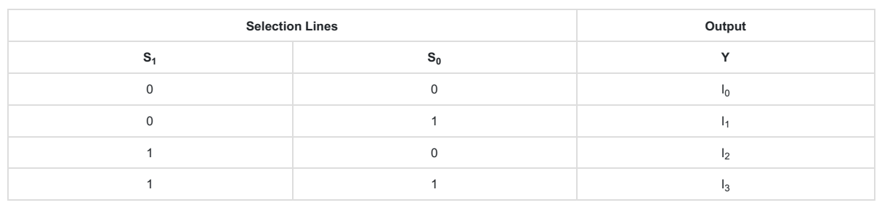
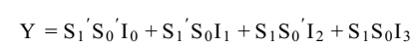
4x1 Multiplexer
Truth table of 4x1 Multiplexer
From Truth table, we can directly write the Boolean function for output, Y as

Slide 5
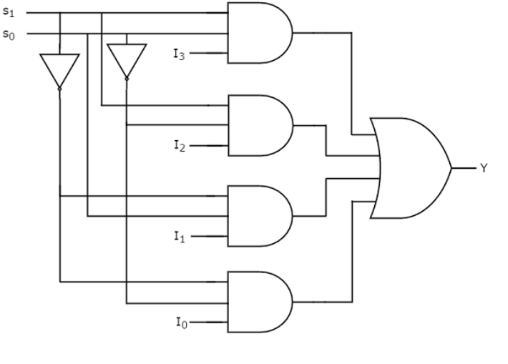
4x1 Multiplexer
We can implement this Boolean function using Inverters, AND gates & OR gate.
The circuit diagram of 4x1 multiplexer is shown in the following figure.

Slide 6
Verilog Code
module mux(s1,s2,a,b,c,d,y);
input s1,s2,a,b,c,d;
output y;
assign y = ~s1&~s2&a | ~s1&s2&b | s1&~s2&c | s1&s2&d ;
endmodule
module test;
reg a, b, c, d, s1, s2;
wire y;
mux obj(s1,s2,a,b,c,d,y);
initial begin
//$dumpfile("mux.vcd");
//$dumpvars( 0, test);
$display("S1\t S2\t A \t B \t C \t D | Y");
$monitor("%b \t %b \t %b \t %b \t %b \t %b | %b",s1,s2,a,b,c,d,y);

Slide 7
Verilog Code
a=0; b=0; c=0; d=0; s1=0; s2=0;
#5 a=0; b=0; c=0; d=0; s1=0; s2=0;
#5 a=0; b=0; c=0; d=1; s1=0; s2=1;
#5 a=0; b=0; c=1; d=0; s1=1; s2=0;
#5 a=0; b=0; c=1; d=1; s1=1; s2=1;
#5 a=0; b=1; c=0; d=0; s1=0; s2=0;
#5 a=0; b=1; c=0; d=1; s1=0; s2=1;
#5 a=0; b=1; c=1; d=0; s1=1; s2=0;
#5 a=0; b=1; c=1; d=1; s1=1; s2=0;
#5 a=1; b=0; c=0; d=0; s1=0; s2=1;
#5 a=1; b=0; c=0; d=1; s1=0; s2=0;
#5 $finish;
end
endmodule

Slide 8
Demultiplexer

Slide 9
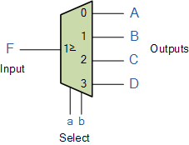
Demultiplexer
The demultiplexer is a combinational logic circuit designed to switch one common input line to one of several seperate output line
The data distributor, known more commonly as the demultiplexer or “Demux” for short, is the exact opposite of the Multiplexer we saw in the previous tutorial.
The demultiplexer takes one single input data line and then switches it to any one of a number of individual output lines one at a time.
The demultiplexer converts a serial data signal at the input to a parallel data at its output lines as shown below.

Slide 10
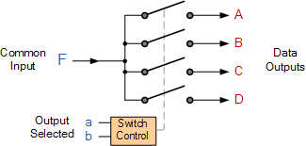
Demultiplexer
1-to-4 Channel De-multiplexer
Output Select |  | Data Output Selected
b | a
0 | 0 | A
0 | 1 | B
1 | 0 | C
1 | 1 | D
The Boolean expression for this 1-to-4 Demultiplexer above with outputs A to D and data select lines a, b is given as:
F = (ab)’A + ab’B + a’bC + abD

Slide 11

Demultiplexer
1-to-4 Channel De-multiplexer
The Boolean expression for this 1-to-4 Demultiplexer above with outputs A to D and data select lines a, b is given as:
F = (ab)’A + ab’B + a’bC + abD
The function of the Demultiplexer is to switch one common data input line to any one of the 4 output data lines A to D in our example above. As with the multiplexer the individual solid state switches are selected by the binary input address code on the output select pins “a” and “b” as shown.
Demultiplexer Output Line Selection

Slide 12
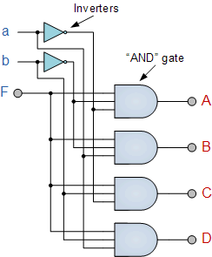
Demultiplexer
4 Channel Demultiplexer using Logic Gates

Slide 13
Code
module demux(s1,s0,a,b,c,d,e,i);
input s1,s0,e,i;
output a,b,c,d;
assign a =i&e&~s1&~s0;
assign b =i&e&~s1&s0;
assign c =i&e&s1&~s0;
assign d =i&e&s1&s0;
endmodule

Slide 14
Code
module test;
reg s1, s0, e, i;
wire a, b, c, d;
demux obj(s1,s0,a,b,c,d,e,i);
initial
begin
//$dumpfile("demux.vcd");
//$dumpvars(0, test);
$display("e\ts1\ts0\td\tc\tb\ta");
$monitor("%b\t%b\t%b\t%b\t%b\t%b\t%b" ,e,s1,s0,d,c,b,a);
i=1; e=0; s1=0; s0=0;
#10 i=1; e=1; s1=0; s0=0;
#10 i=1; e=1; s1=0; s0=1;
#10 i=1; e=1; s1=1; s0=0;
#10 i=1; e=1; s1=1; s0=1;
//$finish;
end
endmodule

